Slide 1

Data Visulalization Software
“Unleash the power of your data with mesmerizing visualizations!"

Slide 2
Team Members
Farhan Abdulla - SCM22CS094
Fathima Mehar - SCM22CS097
Fidha V S - SCM22CS099
Malavika Ravi - SCM22CS139

Slide 3
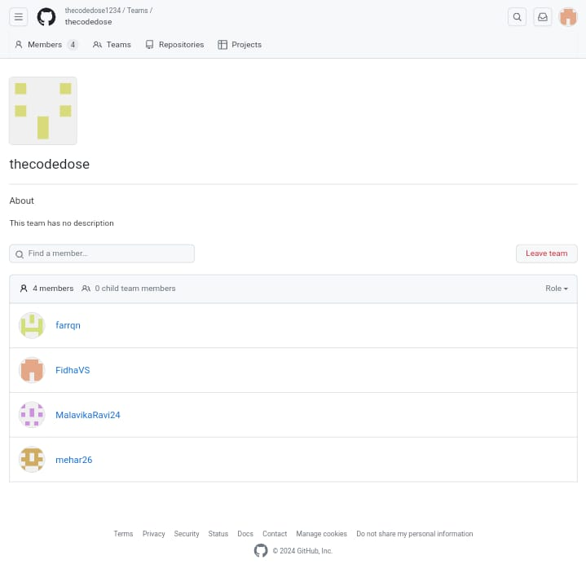

GitHub
thedecodedose
Link : thecodedose1234 · GitHub

Slide 4





LinkedIn
Farhan Abdulla
Fathima Mehar
Fidha VS
Malavika Ravi
LINK : Farhan Abdulla | LinkedIn
LINK : Fathima Mehar | LinkedIn
LINK : Fidha Vs | LinkedIn
LINK : Malavika Ravi | LinkedIn

Slide 5
Problem Statement
Businesses struggle to interpret large volumes of data effectively.
Traditional data presentation methods lack clarity and fail to communicate insights.
Creating interactive and dynamic visualizations on the web requires specialized skills and tools.

Slide 6
Solution
Develop data visualization software for web environments.
Leverage modern web technologies like HTML5, CSS, and JavaScript frameworks (e.g., D3.js, Chart.js).
Enable users to create interactive, responsive, and visually appealing data visualizations.
Allow for dynamic exploration of data to uncover patterns and make informed decisions.

Slide 7
Stack Used
Front-end
Javascript
HTML
CSS
Back-end
Javascript

Slide 8
Features
Interactive Visualizations : Filters, tooltips, and drill-down capabilities for deeper exploration.
Responsive Design: Adaptability to different screen sizes and devices.
Customization Options : Colors, layouts, and chart types tailored to user preferences.
Real-time Data Updates : Support for live data feeds and dynamic updates.
Integration : Connect with databases, APIs, and spreadsheets for seamless data import.
Export and Sharing : Multiple export formats (e.g., PNG, PDF) and easy sharing via social media or links.
Collaboration : Annotate, comment, and share insights with team members.
Security : Robust measures to protect sensitive data and ensure compliance with regulations.

Slide 9
References
Heer, J., & Agrawala, M. (2006). Software design patterns for information visualization.
Murray, S. (2017). Interactive Data Visualization for the Web: An Introduction to Designing with D3.
Segel, E., & Heer, J. (2010). Narrative visualization: Telling stories with data.

Slide 10
Thank you!
-thecodedose

